Slide 1
Independence day by Peter Soren and Alban
What?
Where?
Who?
Why?
When?

Slide 2
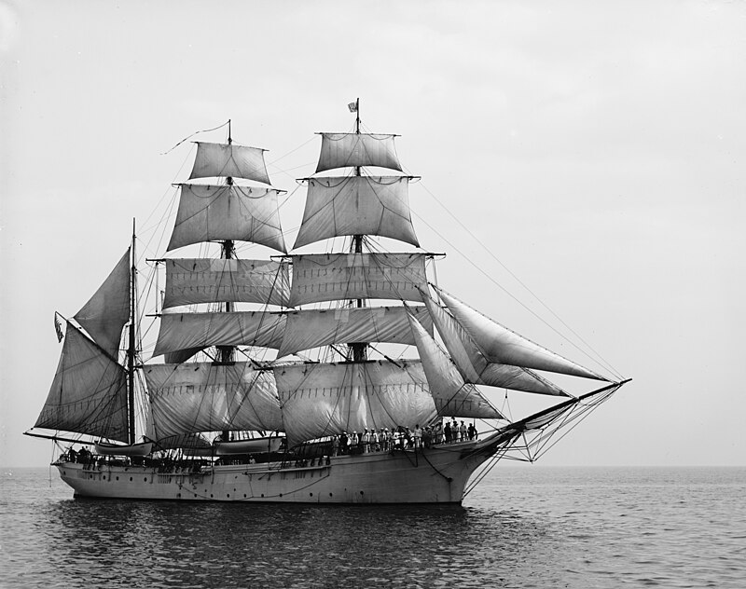
The arrival of the english
Who?
How?
When?
What did they do?

Slide 3
The revolt of the futur americans
Who?
How?
Why?
When?

Slide 4
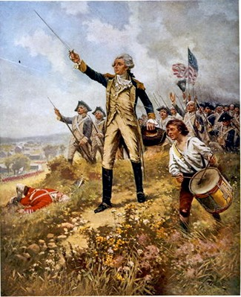
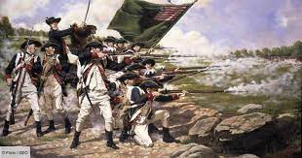
The war of independence
Who won the war?
What happened?
How many year did the war last ?

Slide 5
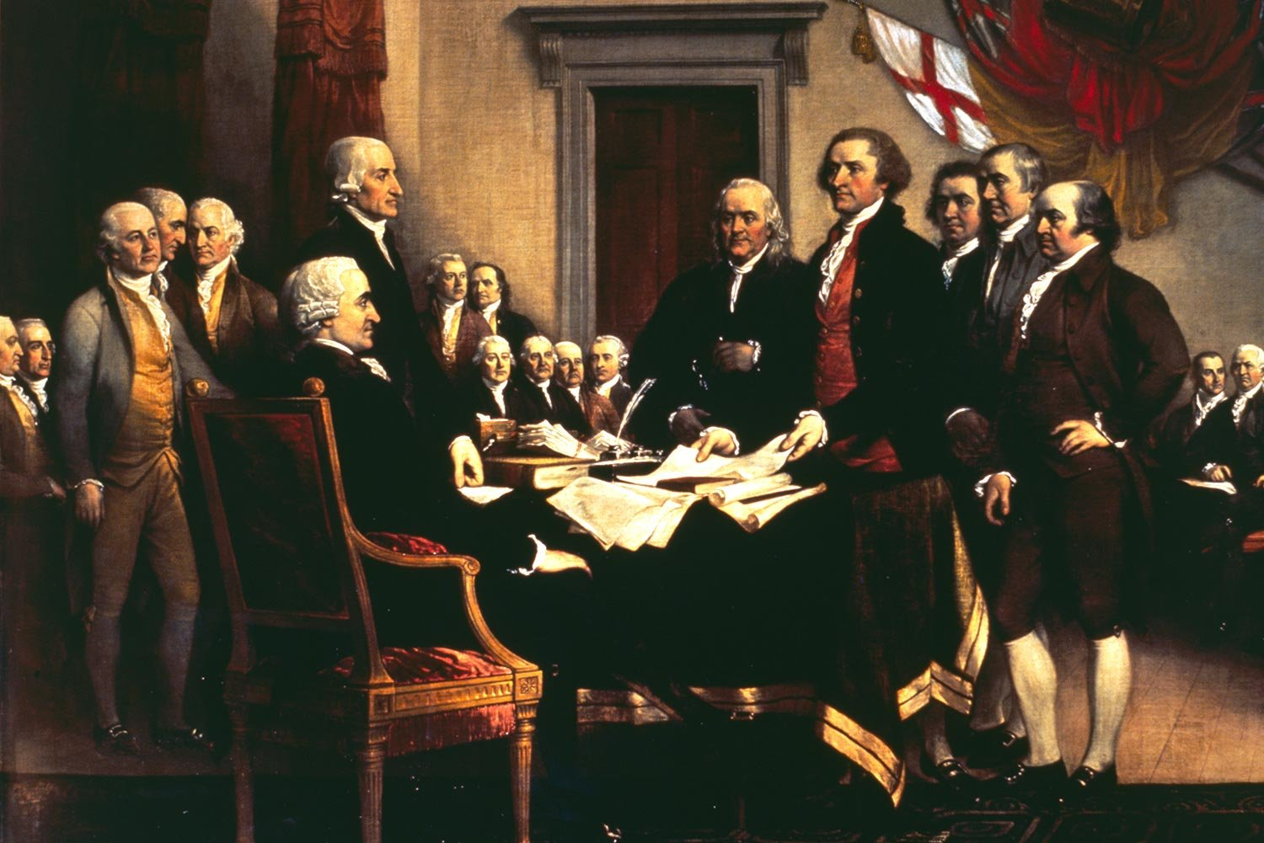
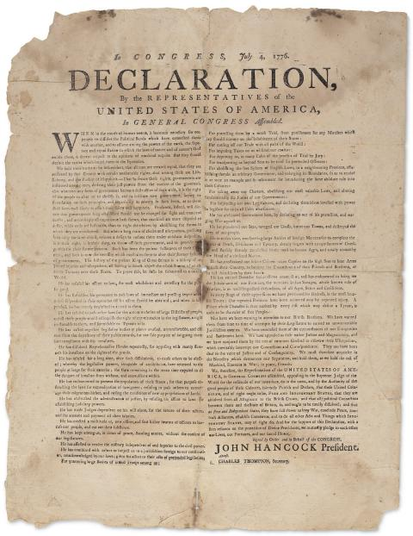
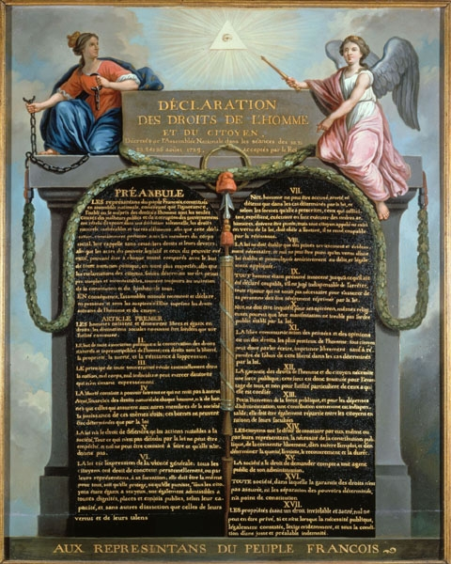
A special letter by the 2nd continental congress to king george 3rd
What?
By who?
Like the ddhc?
Adopted?

Slide 6
The USA
The end of the history..

Slide 7
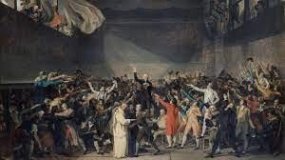
Influence to the french
The same libertys?
The revolte of the french against the absolute monarchy...
The self confident of the parisiens?
The ideas of the Enlightenment...

