Slide 1
Independence day
Matteo Soulard Pedro ; Nils de Sousa Manier ; Lucas Darphel

Slide 2
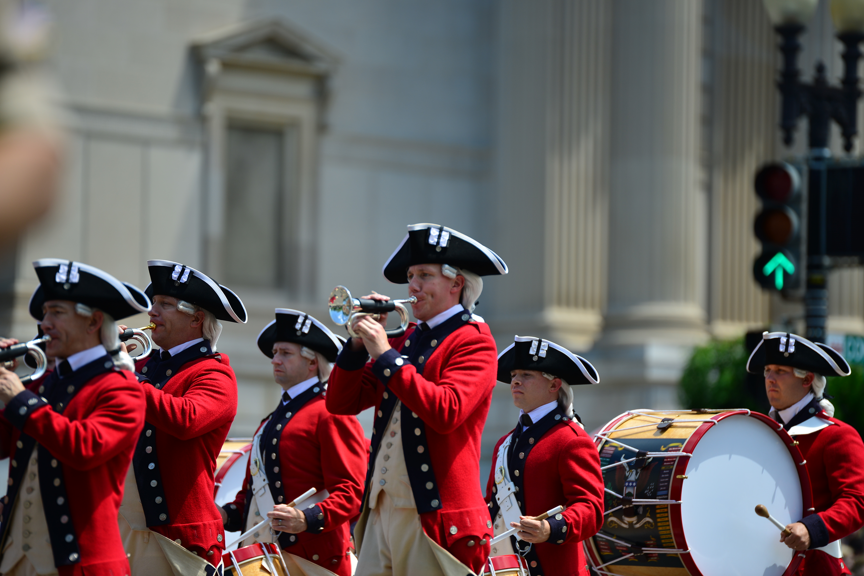
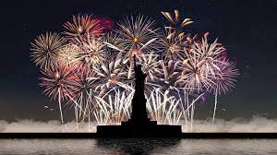
What do they do in Independence day today

Slide 3
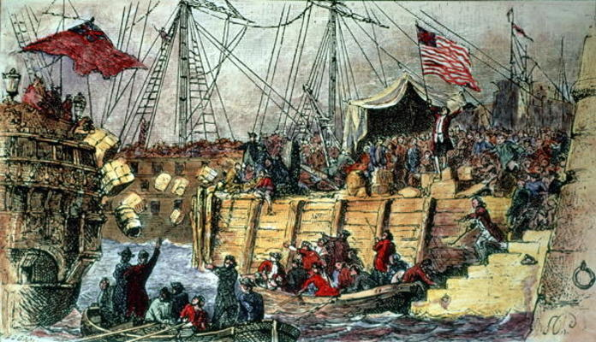
The cause of the separation between the thirteen colonies and the Brithish
The Boston Tea Party

Slide 4
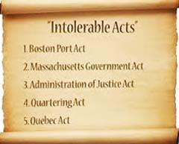
New laws about intolerable Acts

Slide 5
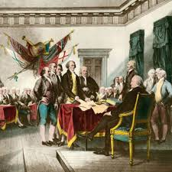
Thomas Jefferson wrote the Declaration of Independence

Slide 6
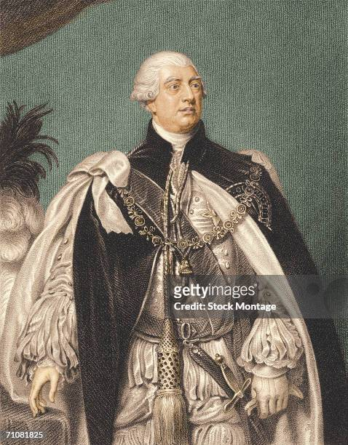
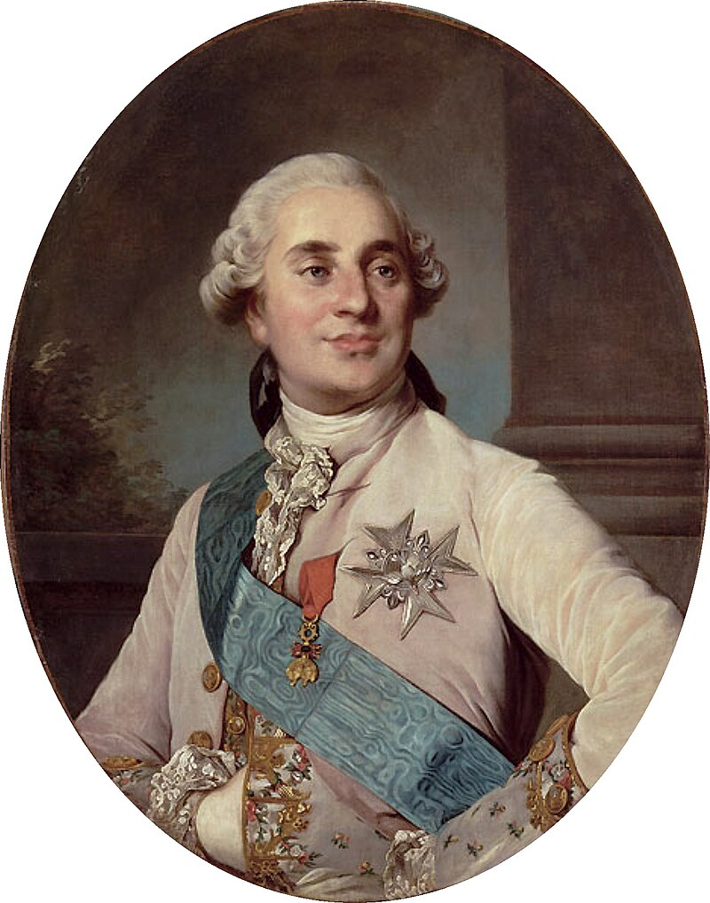
How the american revolution impact the french revolution
King George III
Louis XVI

Slide 7
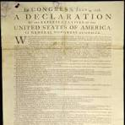
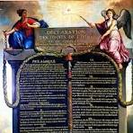
The declaration of Independance influence the DDHC

