Slide 1
INDEPENDENCE DAY
4th of July
Celebration of the independence day

Slide 2
Protests in Boston and the intolerable acts
New taxes and laws
Sons of liberty
Boston tea party
Boston blockade

Slide 3
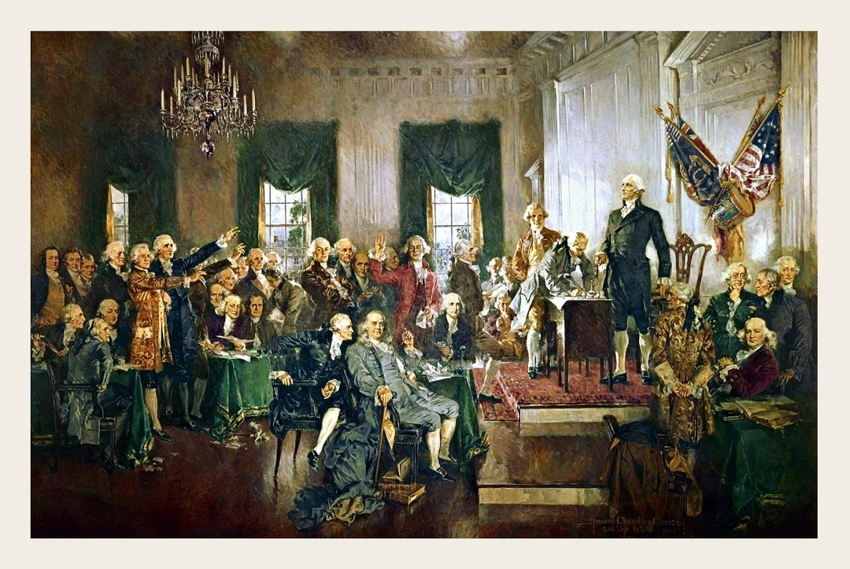
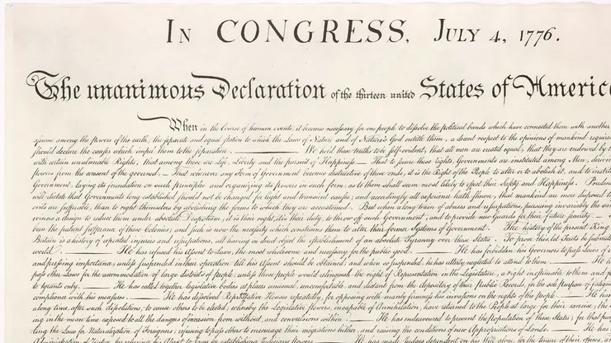
First continental congress
Petition

Slide 4
The War
Orders from King George III
The war

Slide 5
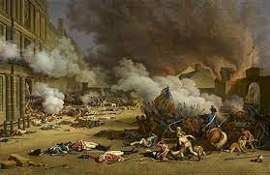
The Enlightment and revolution influence
They wanted freedom
Common points:
- the taxes
- the representation
- The "DDHC"

Slide 6
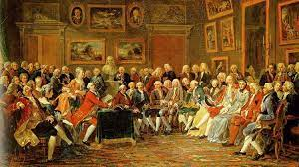
Inspiration
- The ideas of the Enlightement inspired the leader

