Slide 1
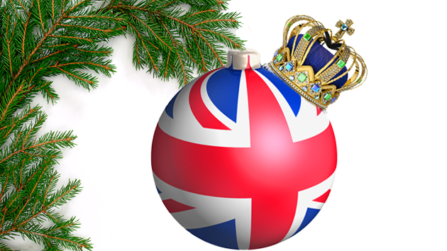
CHRISTMAS IN BRITAIN

Slide 2
In some families, it all begins with the making of the Christmas pudding , some days or weeks in advance !!

Slide 3
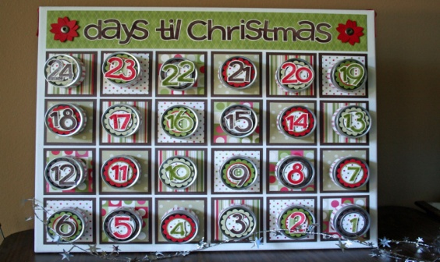
Then with Advent It is a time of waiting for the arrival of Christmas. the Advent Calendar or the Advent Wreath

Slide 4
The custom of sending Christmas cards to friends and family originated in Britain, too.
In 1843 John Calcott Horsley designed the first one for Sir Henry Cole.

Slide 5
On Christmas Eve , groups of singers ( often children ) sing carols , from house to house.

Slide 6
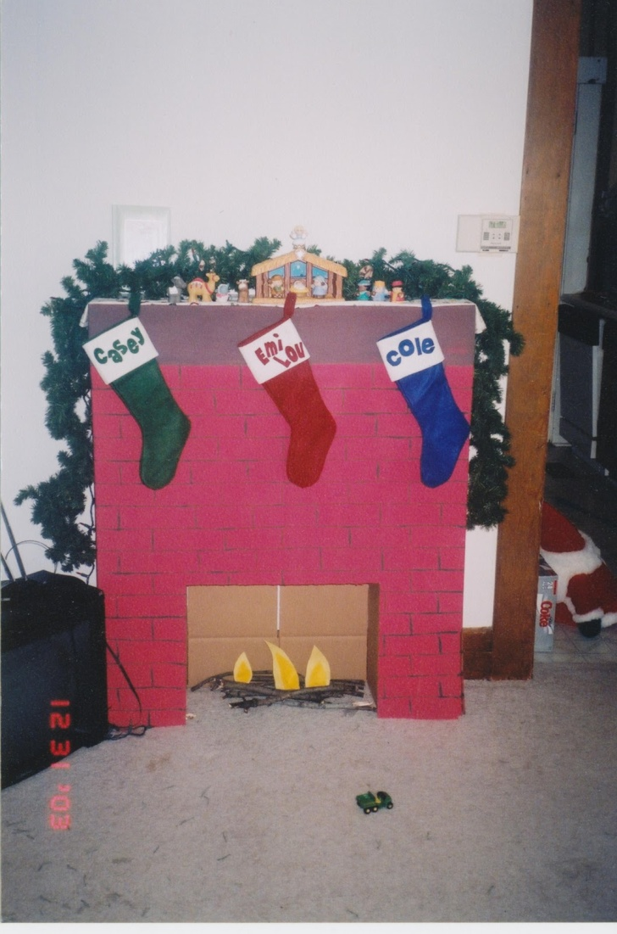
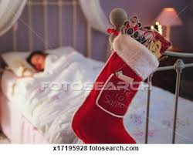
Children hang a stocking on the fireplace or at the foot of their bed for Father Christmas to fill.

Slide 7
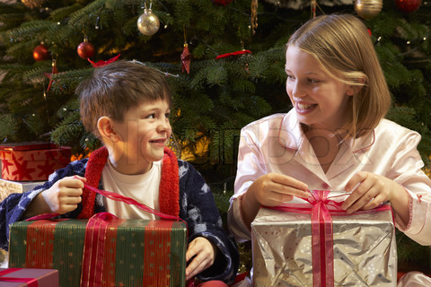
On Christmas Day presents are opened in the morning.

Slide 8
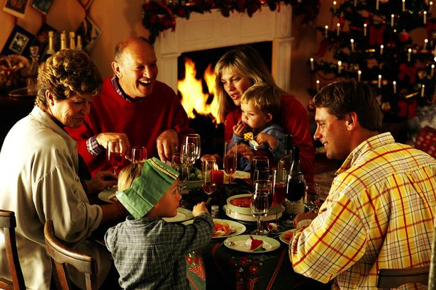
Later the family will gather for the traditional Christmas dinner

Slide 9
With crackers of course !

Slide 10
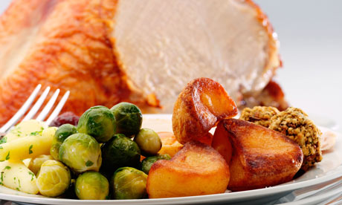
On the menu
Brussels sprouts, fried potatoes with roast turkey, roast beef or goose

Slide 11
Or more complete

Slide 12
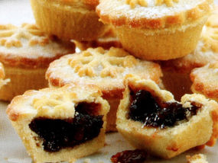
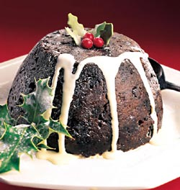
For dessert
Sweet mince pies
Christmas Pudding

Slide 13
For afternoon tea Christmas cake is offered.

Slide 14
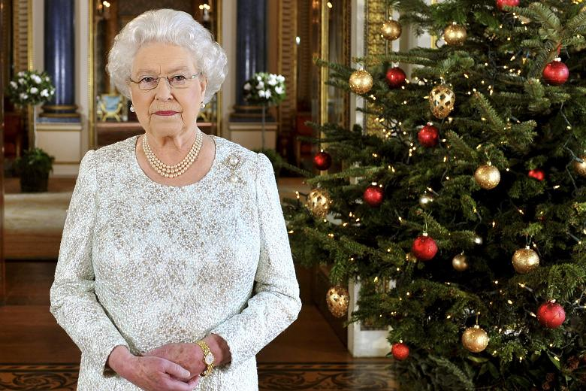
The annual broadcasting of the Queen's Christmas Message is on Christmas Day afternoon.

Slide 15
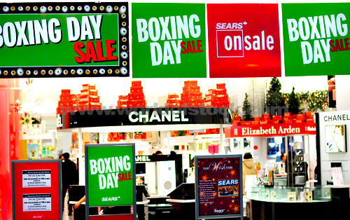
Boxing Day is on December 26th
It is a bank or public holiday
It is also Staint Stephen’s Day , a religious holiday
It is also a shopping holiday with sales
This day takes its name from a former custom giving a Christmas box to delivery men and trades people called regularly through the year.

Slide 16
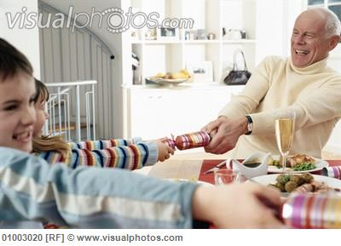
What are they doing ?
They are pulling a cracker

Slide 17
What is he doing ?
He is opening his present

Slide 18
What are they doing ?
They are singing carols

Slide 19
What is he doing ?
He is eating a big Christmas pudding ( on fire !)

Slide 20
What are YOU doing ?!!!!!
We are having fun in English !

Slide 21
THE END

