Slide 1
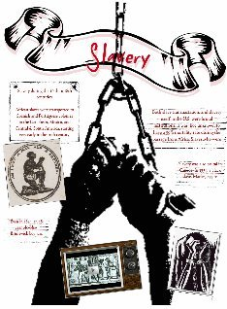
( the roots of discrimination)

Slide 2
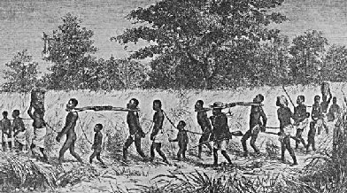
Hundreds of years ago black people were bought and sold as slaves.

Slide 3
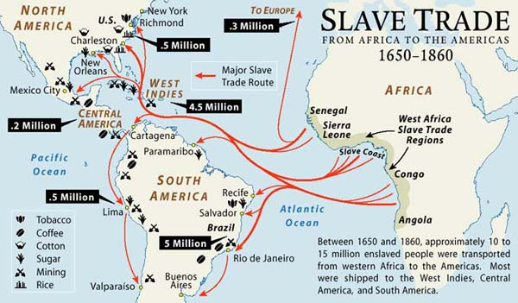
Then the slave trade ….

Slide 4
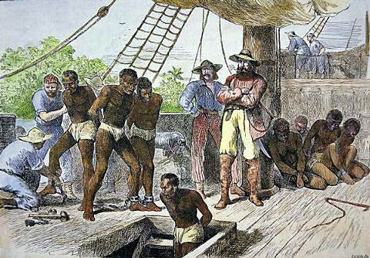
Life conditions aboard the ships … Comment …

Slide 6
They arrived in the US

Slide 8
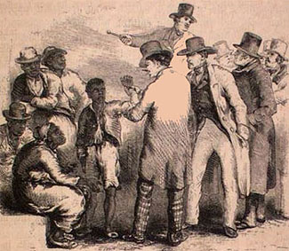

Slide 9
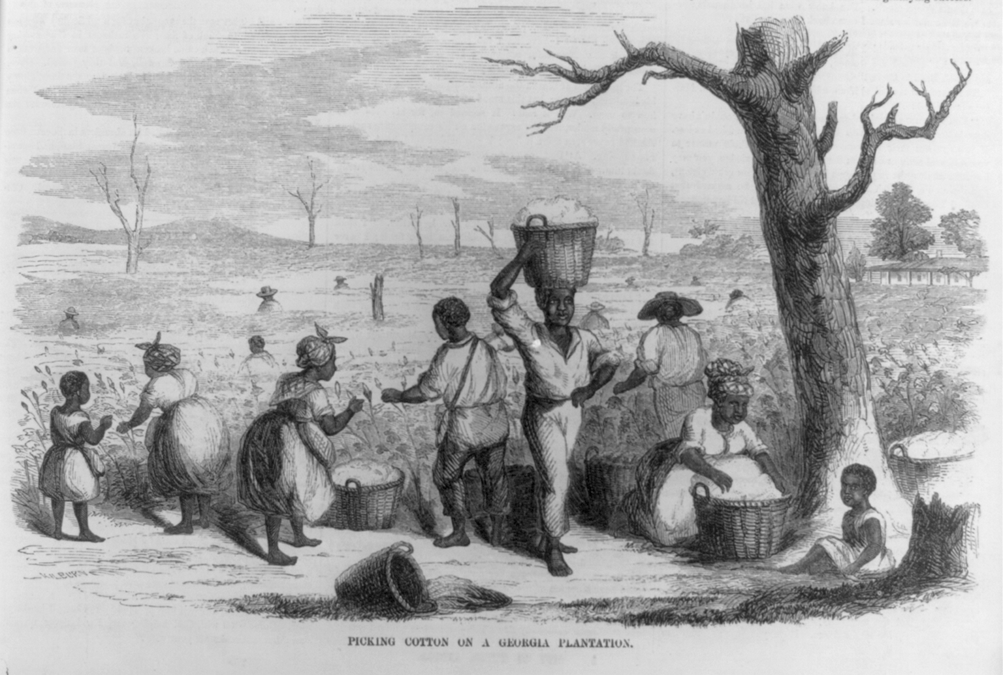
Life in the Deep South Plantations was hard

Slide 10
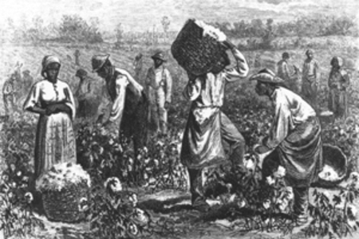

Slide 11
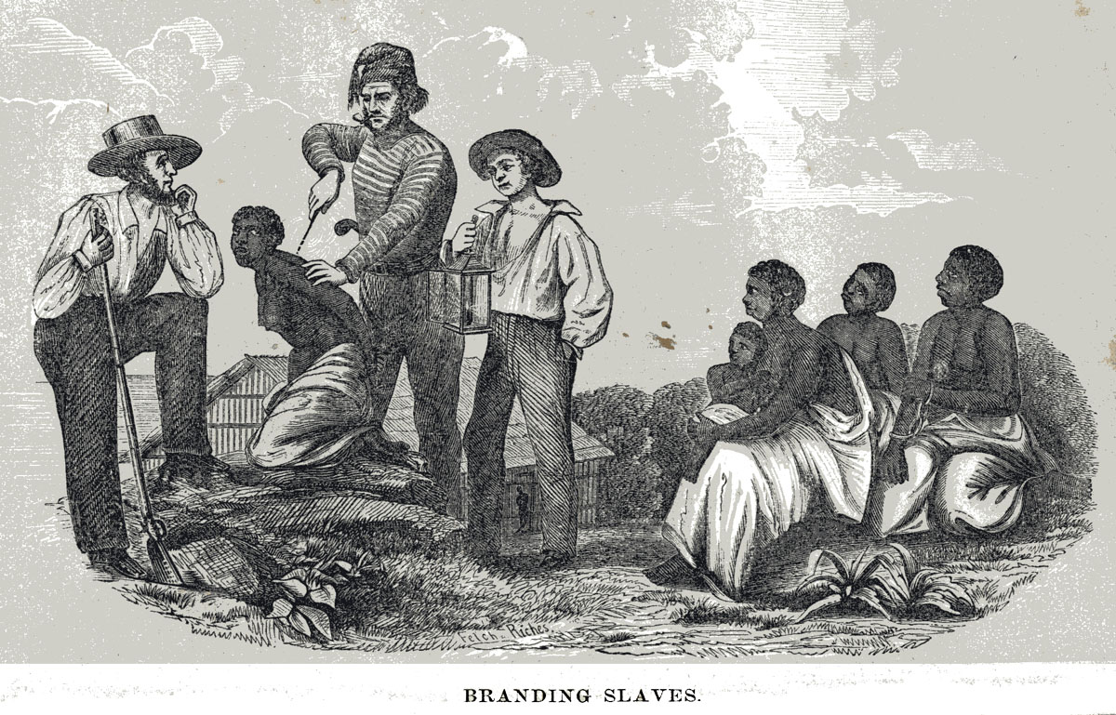

Slide 12
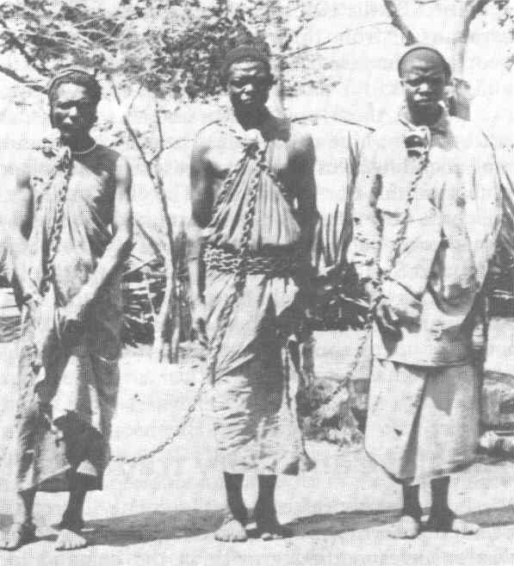

Slide 13
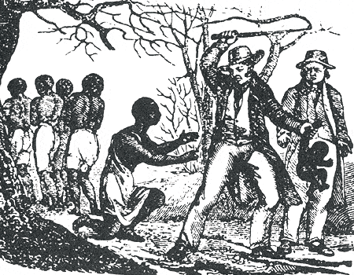

Slide 15
1862

Slide 16
1865

