Slide 1
WHAT ARE THE CAUSES ?

Slide 2
WHAT ARE THE DAMAGE ?

Slide 3
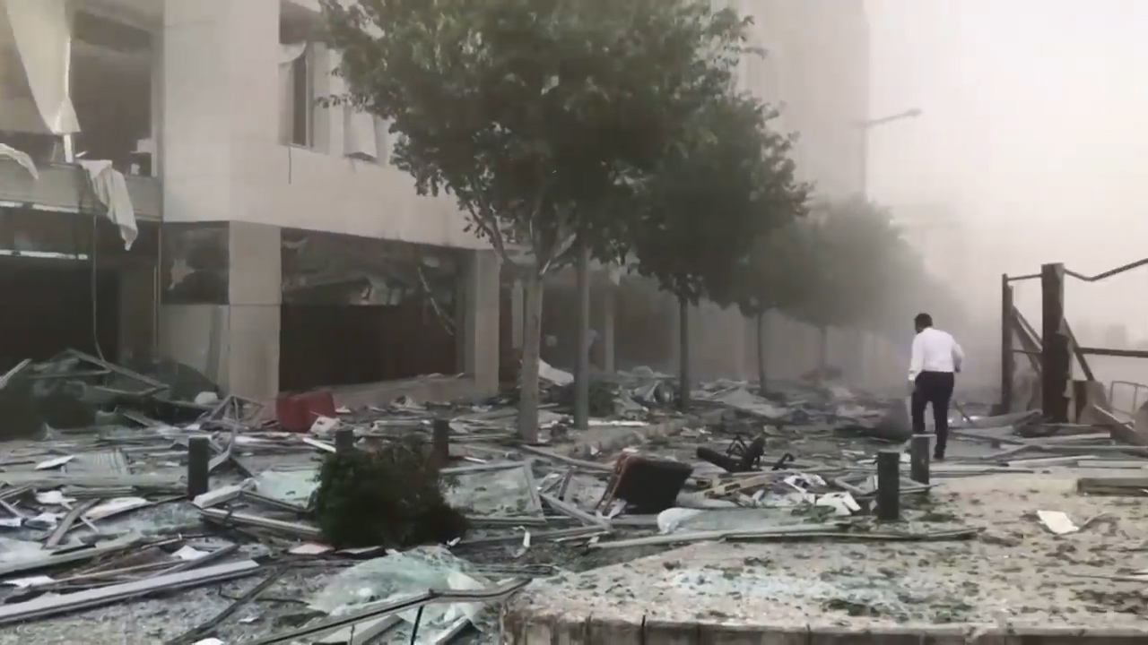

Slide 4
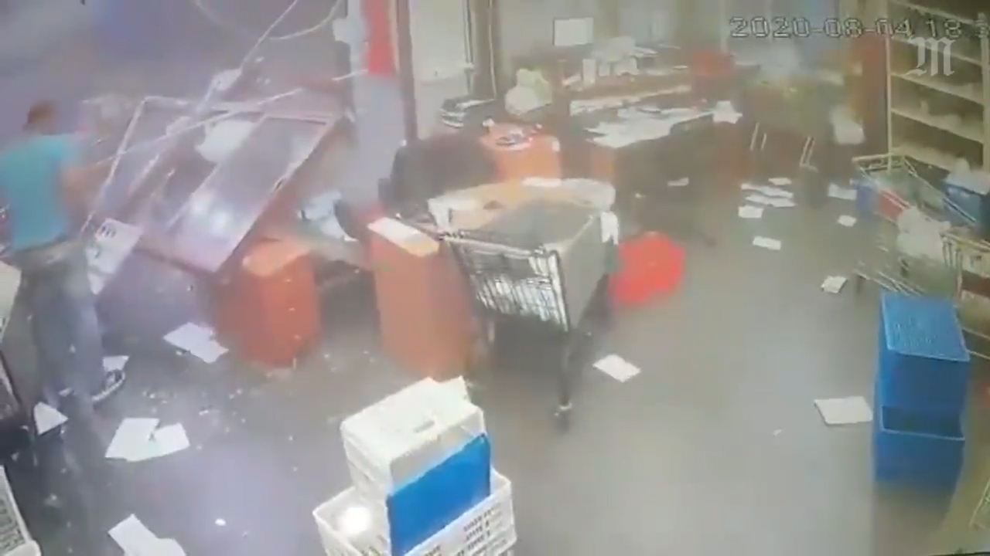

Slide 5
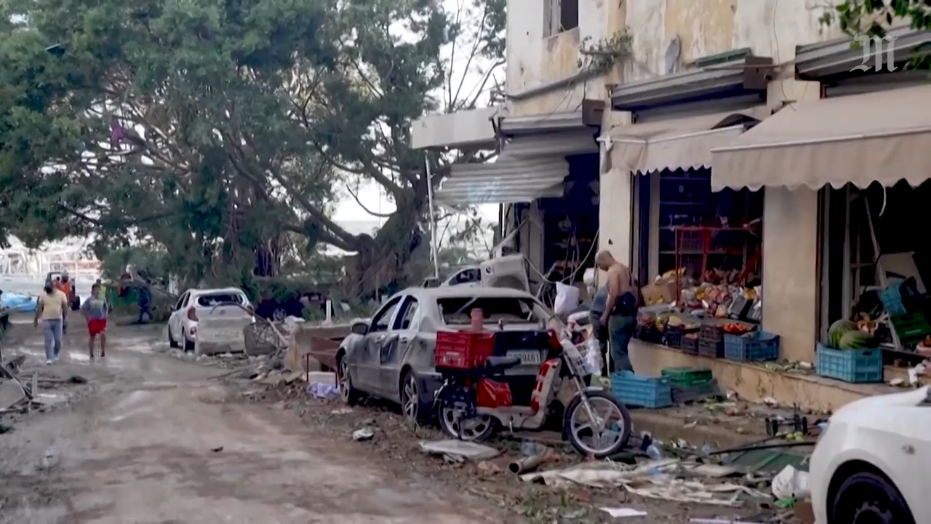

Slide 6
The double explosion

