Slide 1
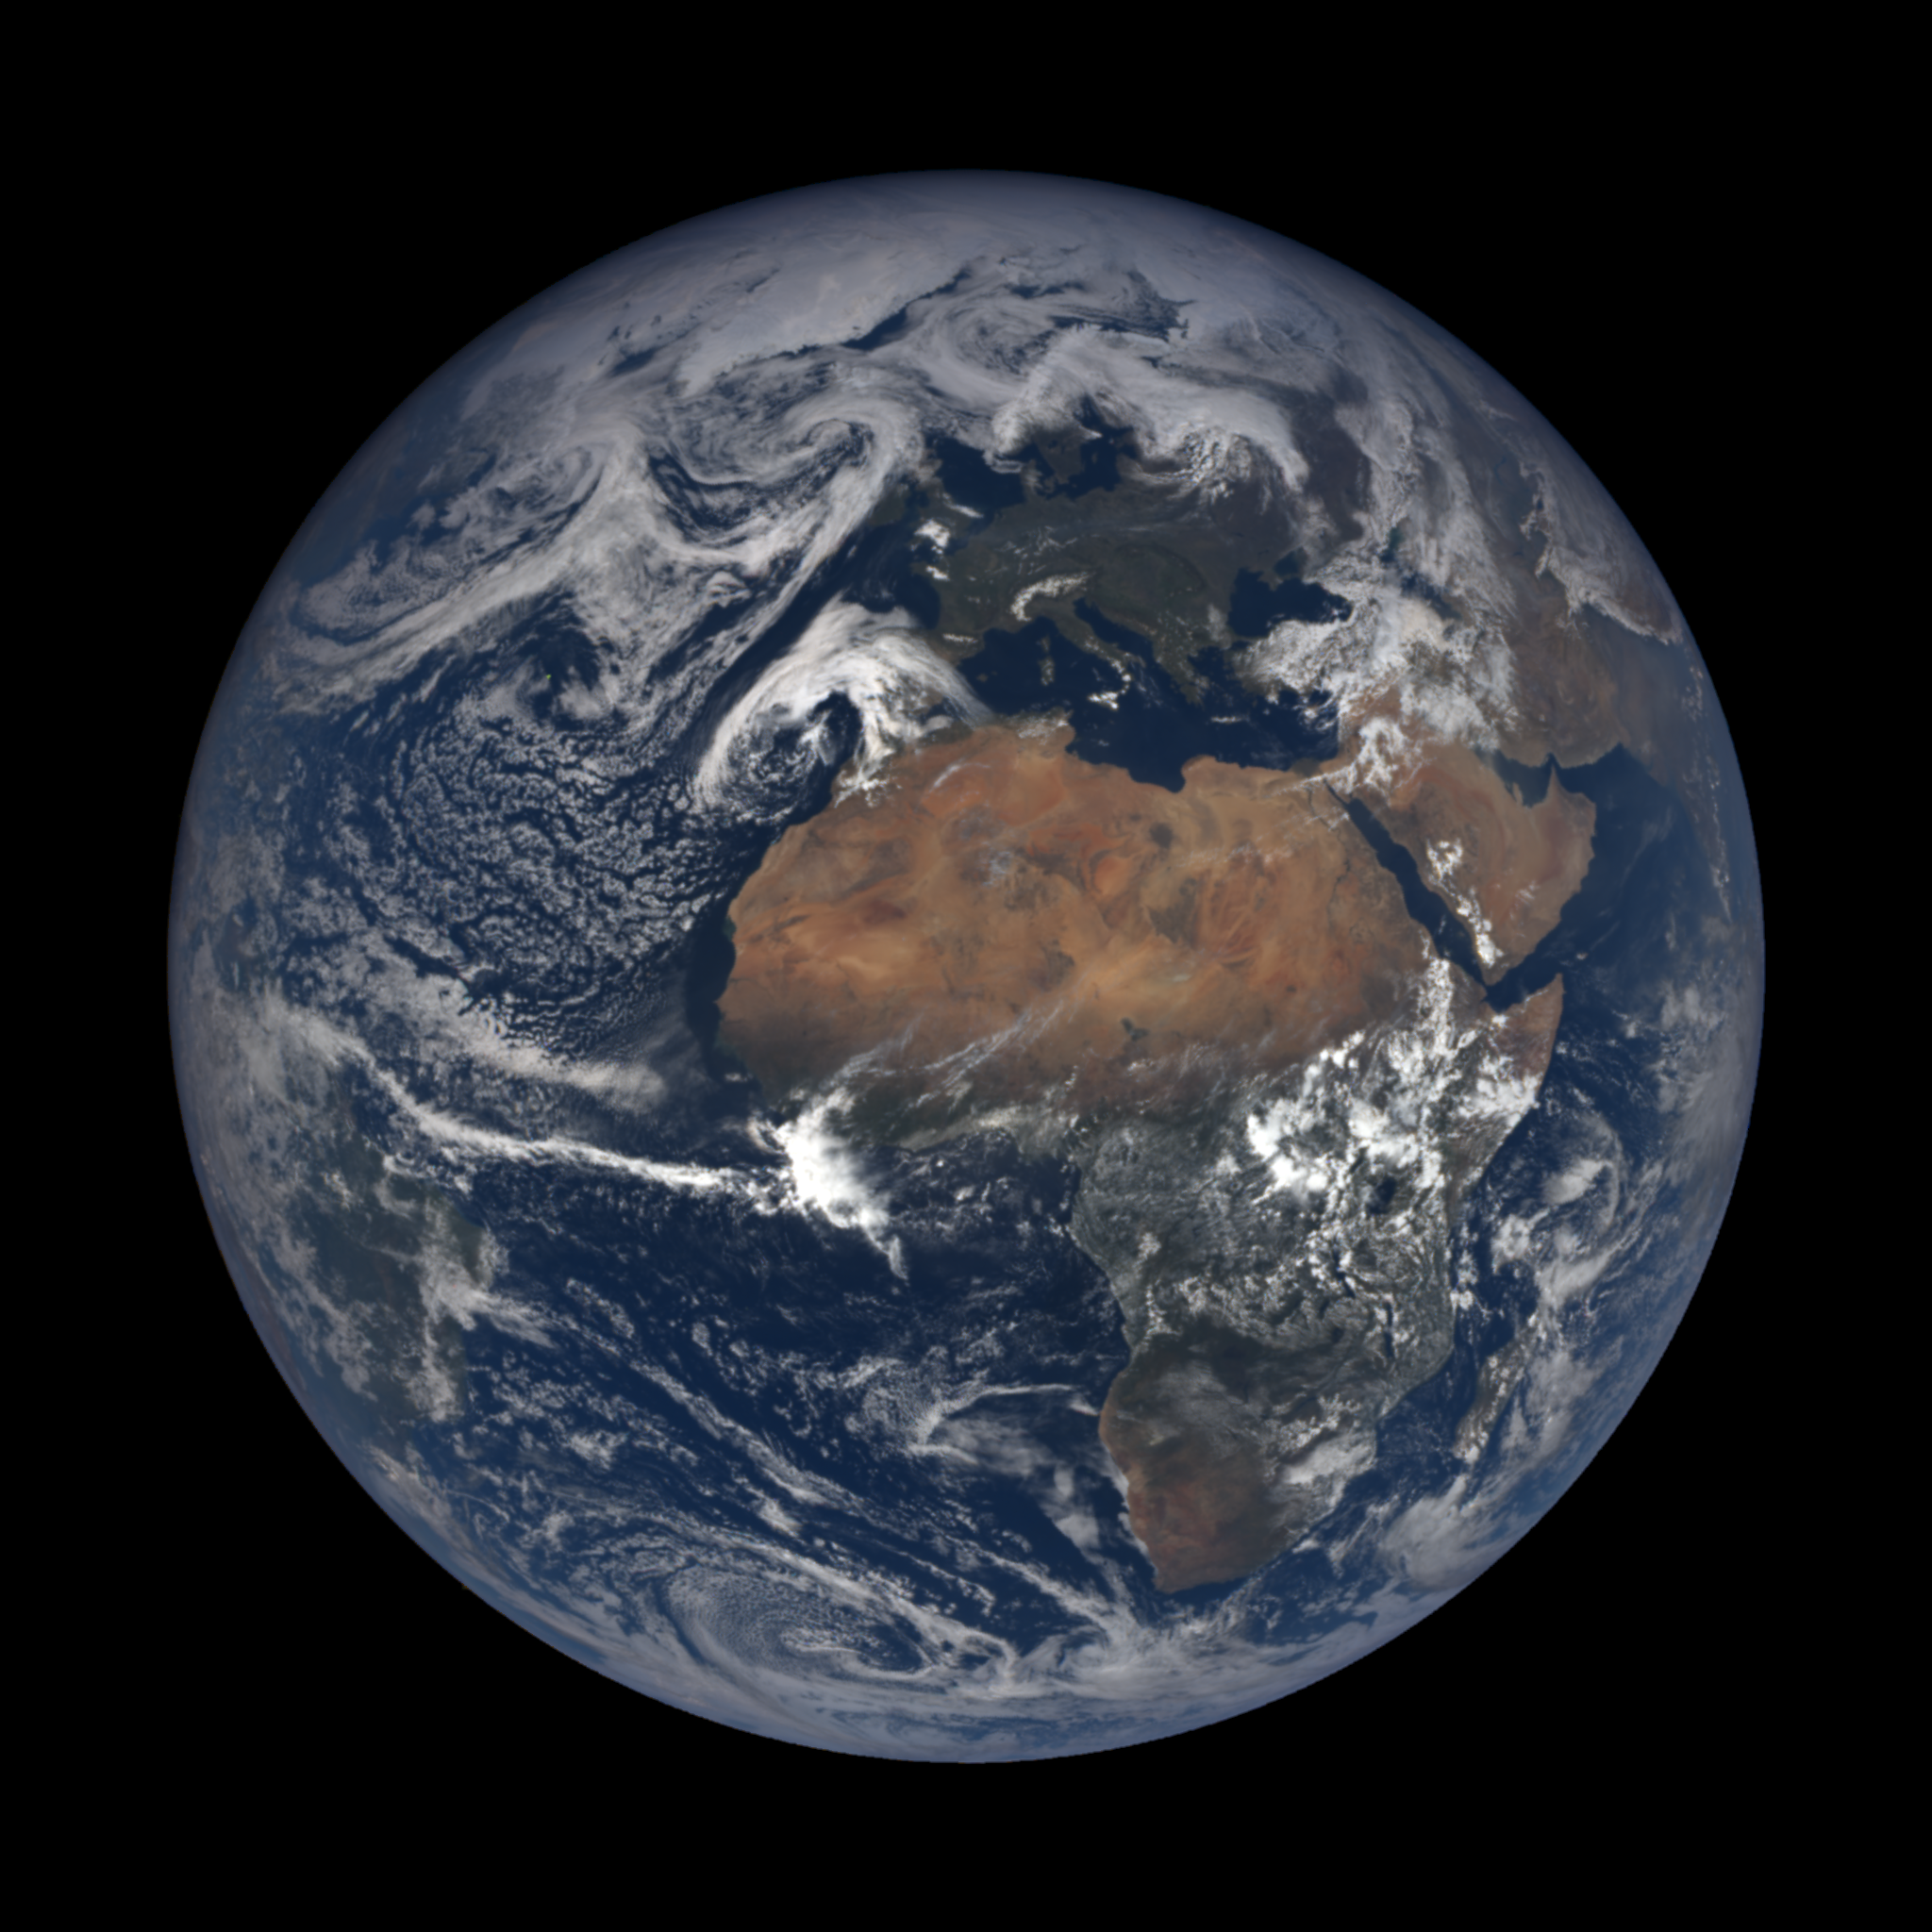
The Earth Overshoot Day

Slide 2
The Earth Overshoot Day is the date when humanity has used all the biological ressources that Earth can renew in one year.
The first countries are Qatar, Luxembourg, Canada... (all the most developped countries) and the last countries are Indonesia, Ecuador, Egypt, Guatemala... (countries in development).

Slide 4
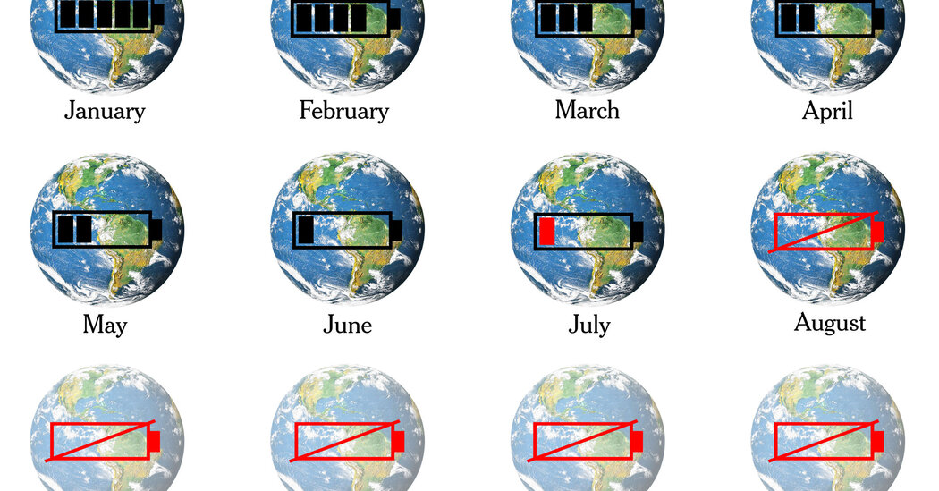

Slide 5
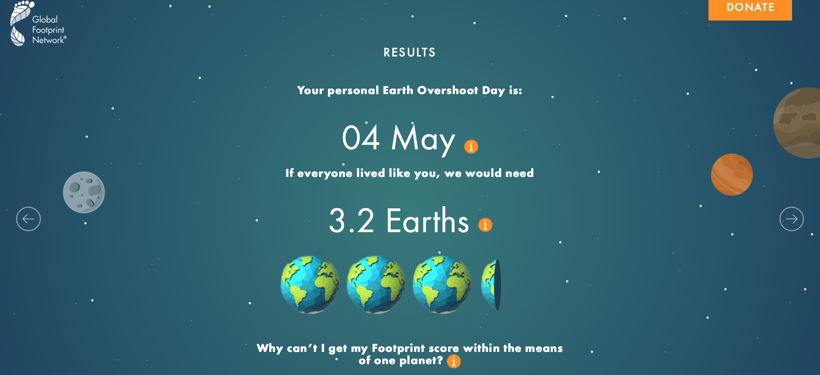
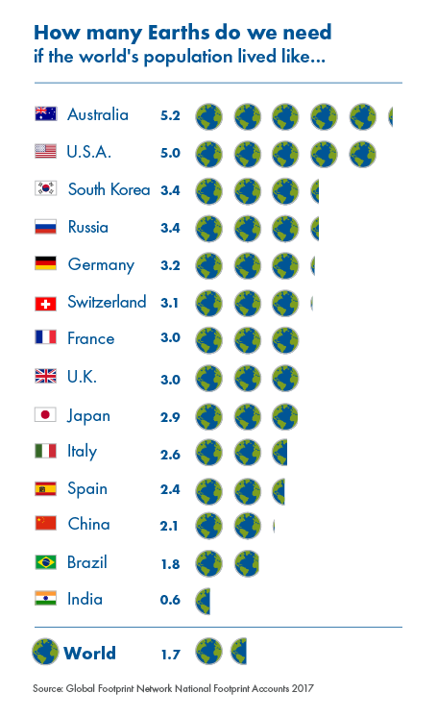
Link to the website : https://www.overshootday.org/

