Slide 1
GREETINGS and GOODBYES

Slide 2
GOOD MORNING

Slide 3
GOOD AFTERNOON

Slide 4
GOOD EVENING

Slide 5
GOOD NIGHT

Slide 6
HELLO / HI
SALUT

Slide 7
HOW ARE YOU?
COMMENT VAS-TU?
COMMENT CA VA?

Slide 8
I’m fine / I’m okay I’m very well / I’m great

Slide 9
I’m so-so

Slide 10
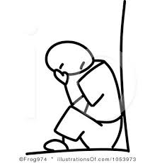
I’m not fine / I’m not well

Slide 11
AUREVOIR

Slide 12
See you tomorrow ! (A demain)
See you later! (A plus tard)
See you on Monday! (A lundi!)
Have a nice weekend! (Bon weekend)

Slide 13
MERCI
DE RIEN

