Slide 1
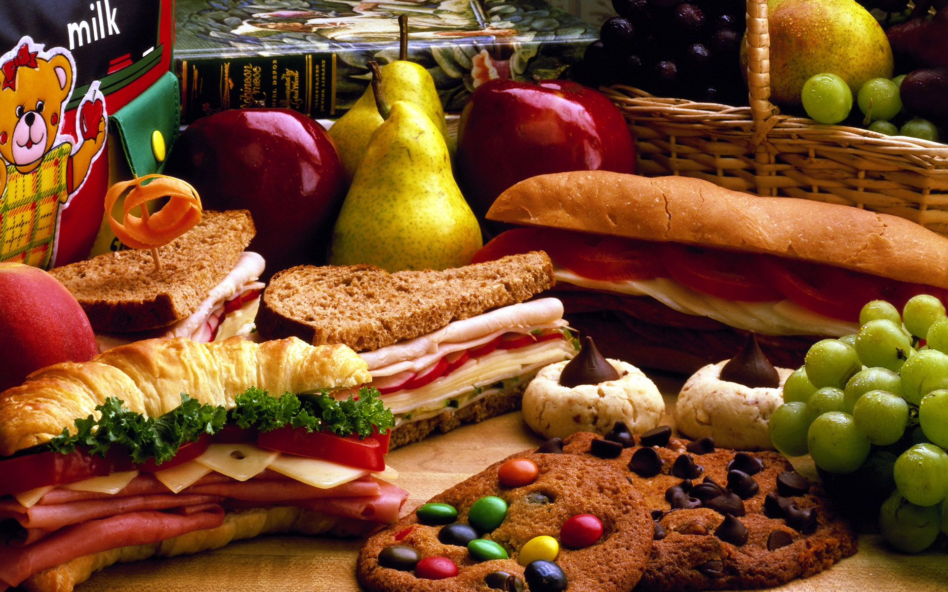
Canadian eating habits

Slide 2
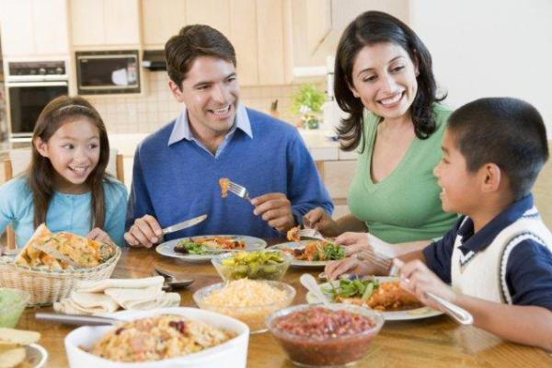
Table manners in Canada
Relaxed and informal
Notes:
Table manners= L’etiquette de table

Slide 3
If you are a guest in a home
Arrive on time for dinner

Slide 4
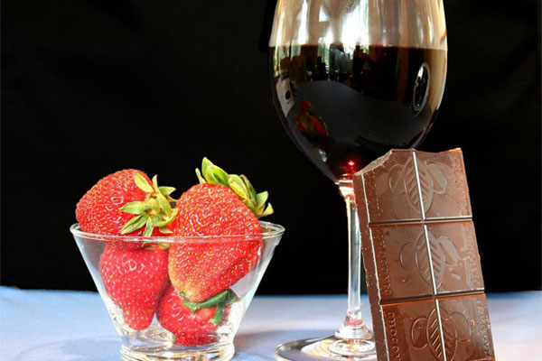
If you are a guest in a home
Bring a small gift (wine, dessert)

Slide 5
If you are a guest in Québec

Slide 6
How to use utensils

Slide 7
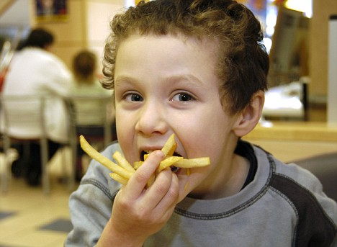
Can you eat with your hands?

Slide 8
When you sit down

Slide 9
Rules while eating

Slide 10
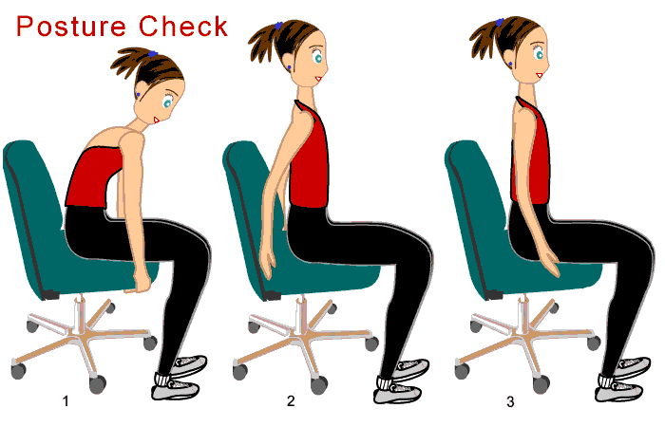
Rules while eating

Slide 11
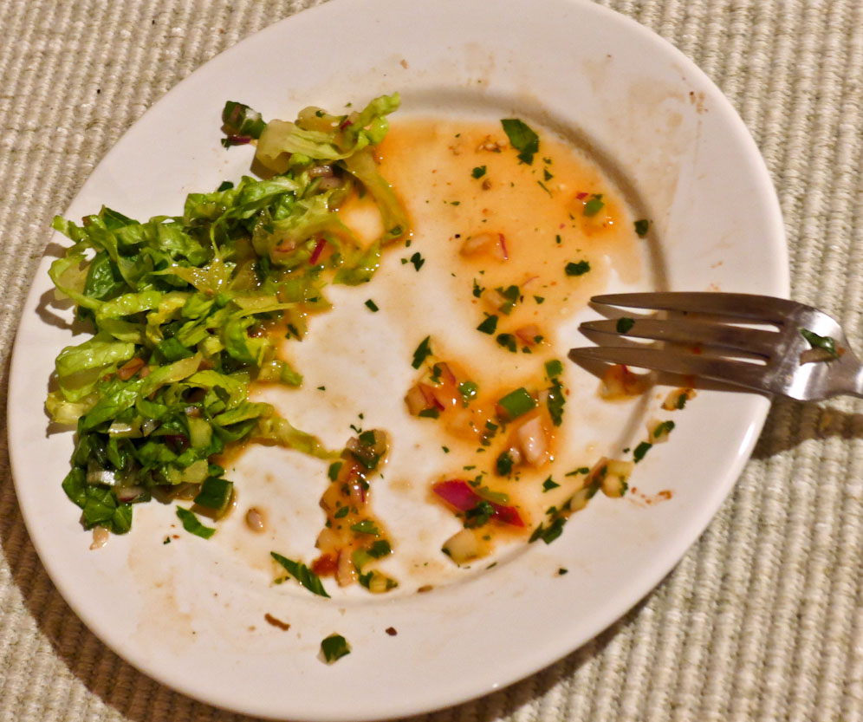
At the end of the meal

Slide 12
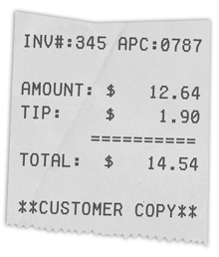
Eating at a restaurant
Give a TIP!

