Slide 1
PAST SIMPLE TENSE

Slide 2
We use Past Simple to talk about actions in the past.
There are two ways to form the past simple:
With verb ‘to be.
With all the other verbs.

Slide 3
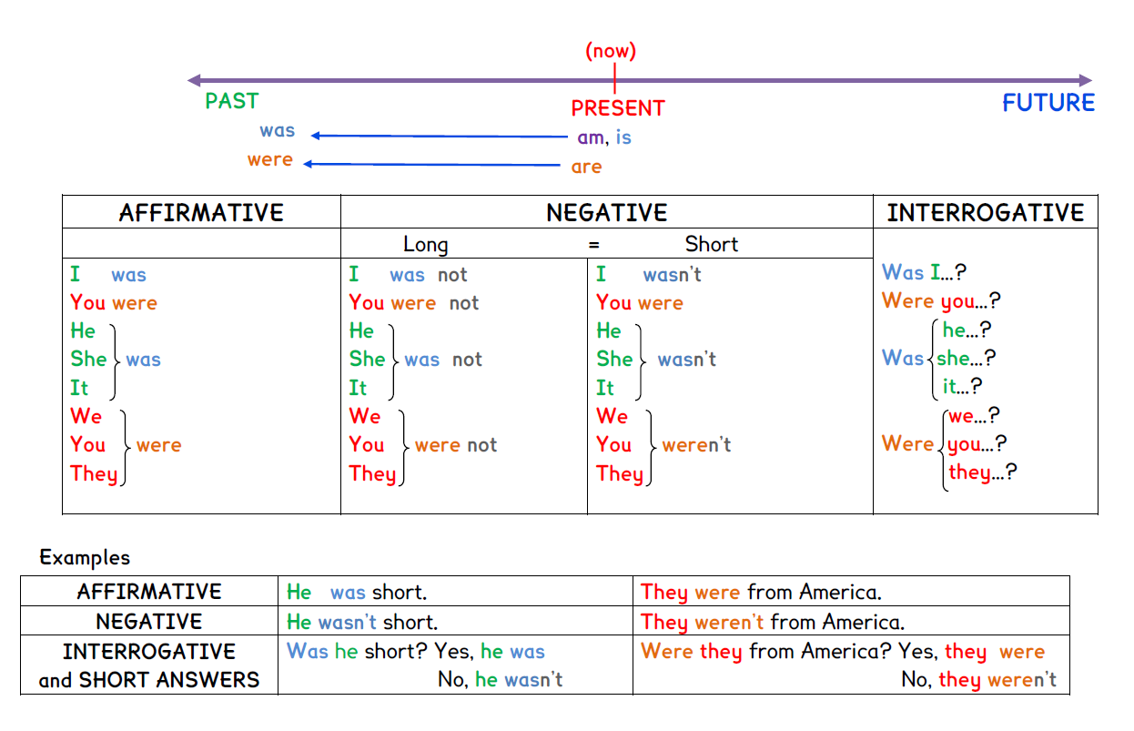
VERB ‘to be’ PAST

Slide 4
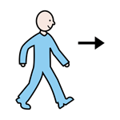
Other verbs in PAST SIMPLE
There are two groups:
REGULAR verbs.
We add –ed to the infinitive form:
play
played
listen
listened
2. IRREGULAR verbs.
We don’t add –ed to the infinitive form.
Irregular verbs need to be memorized ¡
go
went
read
read

Slide 5
Examples:
AFFIRMATIVE:
+
VERB PAST
SUBJECT
Andrew
washed
the car
NEGATIVE:
+
DID
+
NOT
+
VERB
SUBJECT
Andrew
wash
the car
didn’t
QUESTION:
DID
+
SUBJECT
+
VERB
Did
Andrew
wash
the car
?

Slide 6
